Slide 1
CHAPTER 3.3:
USING THE PROPERTIES TOGETHER
Algebra concepts

Slide 2
Objective
Students will calculate the value of an unknown term of a multistep equation through the combination of like-terms.

Slide 3
Use Opposites (Inverse Operations)
Addition (+) OPPOSITE subtraction (-)
Multiplication (x) OPPOSITE division (÷)

Slide 4
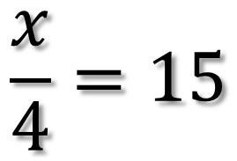

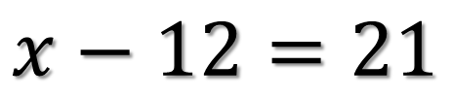
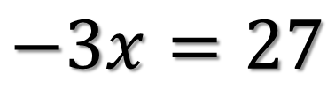
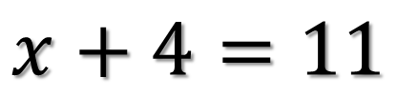
$$Review$$
$$\frac{x}{4}=15$$
$$−3x=27$$
$$x+4=11$$
$$x−12=21$$

Slide 5
Multi-Step Equations
1) Separate the Equation
2) Simplify
A) Distributive Property
B) Combine Like-Terms
3) Should It Stay or Should It Go
4) Solve for Variable

Slide 6
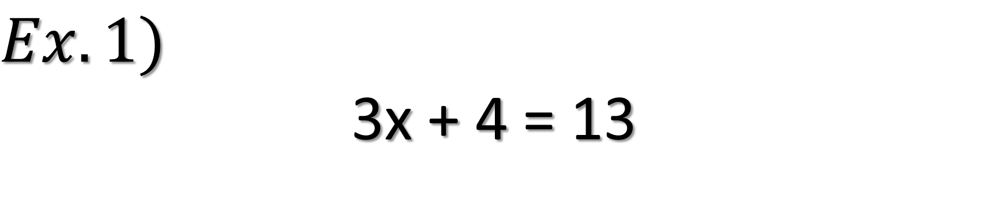
$$Ex.1)$$
3x + 4 = 13

Slide 7
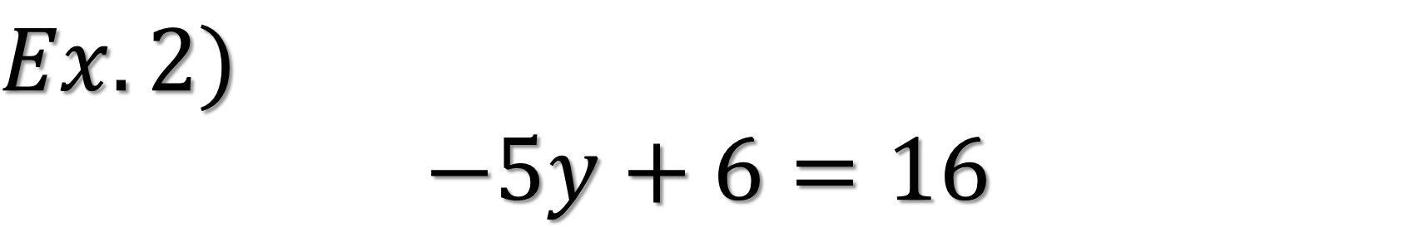
$$Ex.2)$$
$$−5y+6=16$$

Slide 8
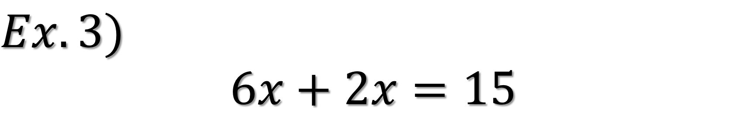
$$Ex.3)$$
$$6x+2x=15$$

Slide 9
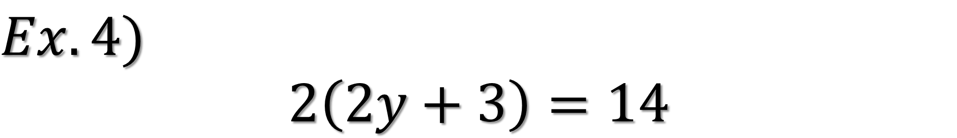
$$Ex.4)$$
$$2\left(2y+3\right)=14$$

Slide 10
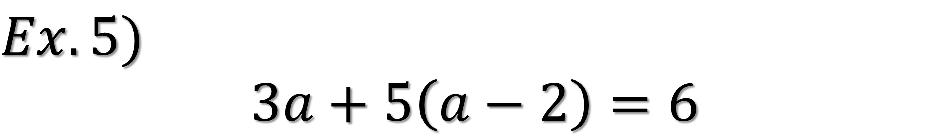
$$Ex.5)$$
$$3a+5\left(a−2\right)=6$$

